Slide 1
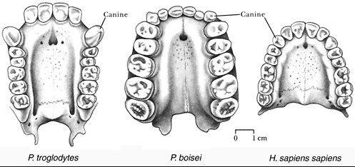
Hominin Evolutionary Trends
Relative size of cerebral cortex
Prognathism and Dentition

Slide 2
Date: | Human Biology Year 12 ATAR
Do Now Past exam question Hand in review worksheet Lesson Agenda 1: Do Now 2: Review recent test 3: Hominin Evolution Cerebral Cortex, Prognathism, Dentition 4: Lesson summary and windup Suggested Study Read through today’s notes and textbook section Complete review worksheet, then mark and correct using the answer key on Connect (compulsory). NEXT LESSON Australopithecines | Learning Aims Compare the human cerebral cortex with that of currently living great apes. Describe evolutionary trends in extinct human ancestors for: Cranial capacity Endocasts and cerebral convolutions Dentition and Dental arcade Jaw shape and size, brow ridges and tooth size
 | Key Vocabulary Endocast Cranial Capacity Dental Arcade Diastema

Slide 3
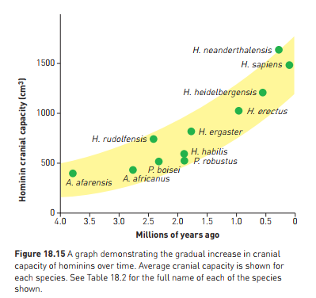
Relative size of Cerebral Cortex
Humans – relatively large brains
Larger than apes
Difference associated with larger cerebral cortex
Physically larger
Has folds to increase surface area (convolutions)
Frontal lobe enlarged
Thinking, reasoning, planning, processing
Large brain requires large cranium
More of skull used for brain in humans than in apes
Brow more vertical, without ridges
Flatter face, more prominent nose
Can see evolutionary trend towards greater cranium size and brain development in extinct human ancestors.
Learning Aim: Compare the human cerebral cortex with that of currently living great apes and extinct human ancestors

Slide 4
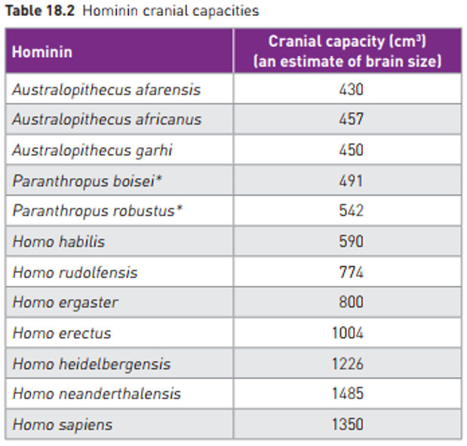
Relative size of Cerebral Cortex
Can see evolutionary trend towards greater cranium size and brain development in hominin ancestors:
Australopithecus afarensis cranium size more similar to modern apes, but has adaptations for bipedalism – indicates brain size increased AFTER bipedalism developed.
Can’t see brain of fossils, but can see cranial capacity, and sometimes endocasts showing convolutions on cerebrum (more on this later)
Gradual increase in relative cranial capacity as more closely related to humans.
Also foramen magnum positioning, rounding of skull.
Sometimes only skull fragments are found – can then be difficult to estimate cranial capacity.
Learning Aim: Describe evolutionary trends in cranial capacity for extinct human ancestors.

Slide 5
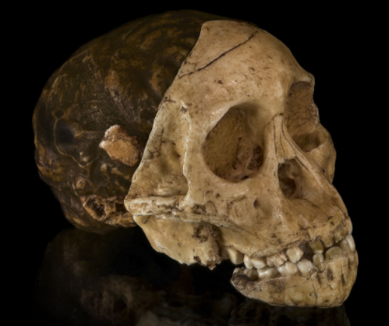
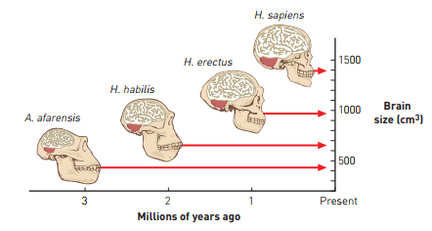
Relative size of Cerebral Cortex
Endocasts
Are “casts” of the inside of the skull – see image
Provide shape of brain surface
May occur naturally, or by scientific casts made of inside of skull
Reveal increase in convolutions and relative size of frontal lobe
Trend can be seen as hominin species become more recent
Even within H.erectus –increase seen between earlier and later fossils
Learning Aim: Describe evolutionary trends in cranial capacity for extinct human ancestors.

Slide 6
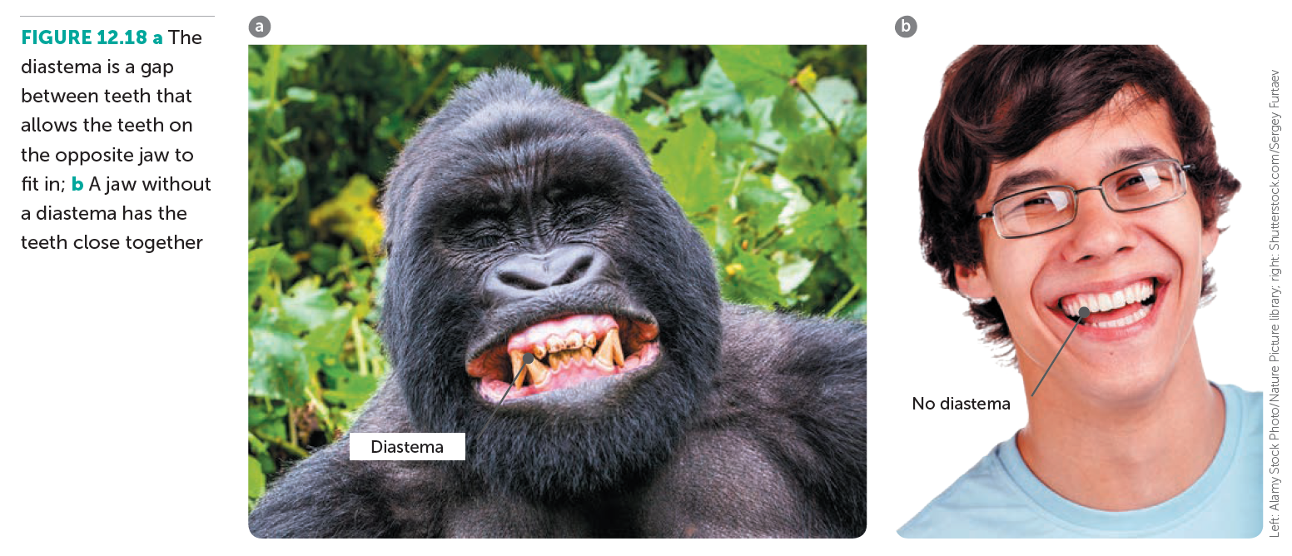
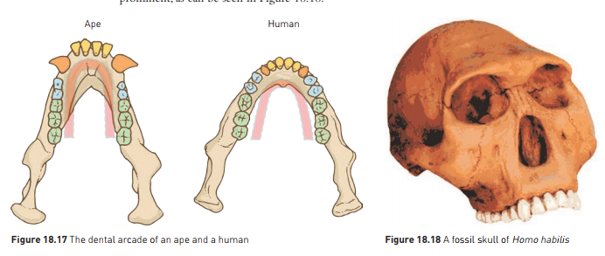
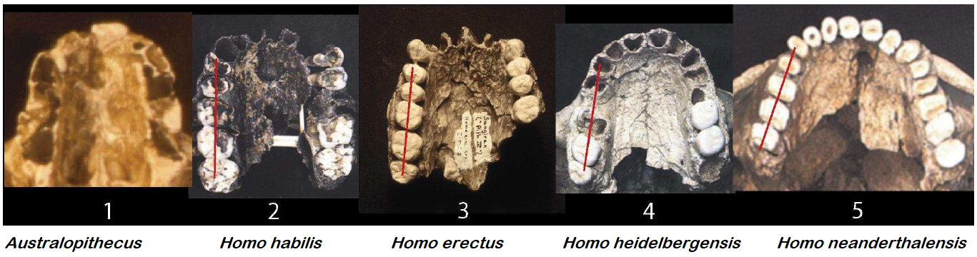
Prognathism and Dentition
Prognathism: forward jutting jaw
Dentition: size, shape and position of teeth
Dentition:
Humans very distinctive compared to other primates
Canines do not protrude or interlock – small canine teeth, no diastema
Parabolic rather than U shaped dental arcade
Change in dental arcade shape is a trend among hominin ancestors:
A. afarensis lower jaw and face ape-like
H. habilis molars and premolars smaller and narrower, still prominent canines
H. erectus smaller and narrower, canines smaller
Early H. sapiens had larger teeth than modern humans
Learning Aim: Describe evolutionary trends in dentition and dental arcade for extinct human ancestors.

Slide 7
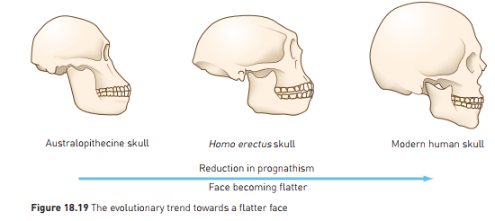
Prognathism and Dentition
Prognathism and Brow Ridge
Apes and early hominins – forward jutting jaw (prognathism) and distinct brow ridge.
Evolutionary trend to flatter face, development of chin and more prominent nose.
Gradual enlargement of frontal lobe led to more distinct forehead, reduction in brow ridge.
Smaller teeth due to dietary changes led to smaller jaw and flatter face – also provides balance for bipedalism.
Learning Aim: Describe evolutionary trends in prognathism, brow ridge and tooth size for extinct human ancestors.

Slide 8
